Slide 1
MLFSOM Simulations Homogeneous Beam (mosaicity turned off)

Slide 2
MLFSOM input parameters
Mosaicity is set to 0.15 and it is the same for each frame
Crystal & Exp. Params
Protein | Tetragonal lyosyzme
PDB code | 1H87
Unit cell | 77.25, 77.25, 38.66
Detector | Pilatus 6M
Mosaicity (initial-final) | 0.15º (does not change)
B-factor (initial-final) | 14.8 – 51.8 A²
Fractional unit cell change | 1% (at the end)
Initial resolution | 1.5 A
Oscillation (stills) | 0.01º
Number of frames | 20
Beam Params
Beam size | 100 micron
Crystal size | 77.8 micron
Wavelength | 1.0 A
Beam dispersion | 0.00014
Beam divergence (hor, ver) | (0.06º, 0.01º)
Exposure per frame | 0.5 sec
Beam flux | 8.4 x 10¹⁰ ph/sec

Slide 3
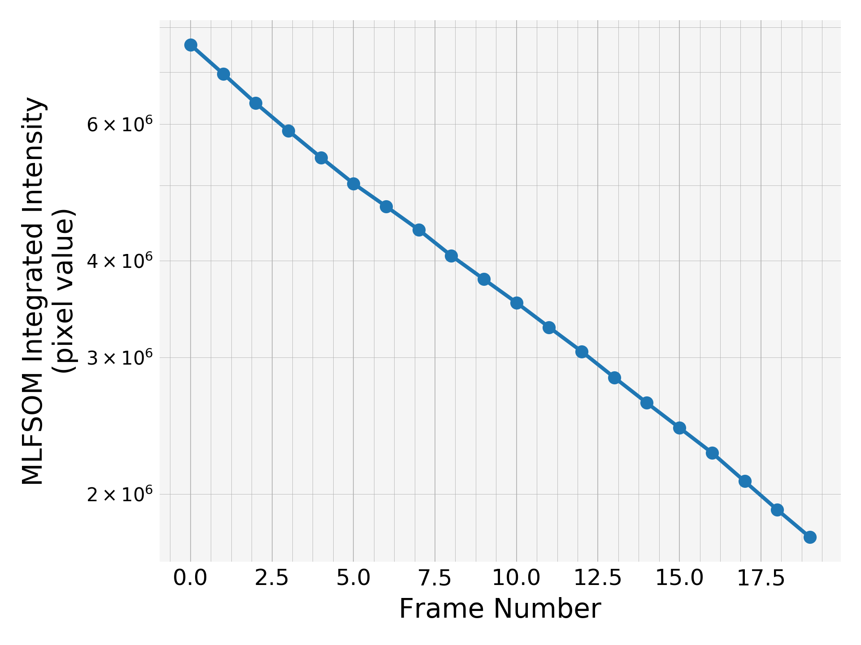
Integrated intensity
Monotonic and very regular decay compared to the simulation with the mosaicity
No increase or lag in the intensity at the beginning

Slide 4
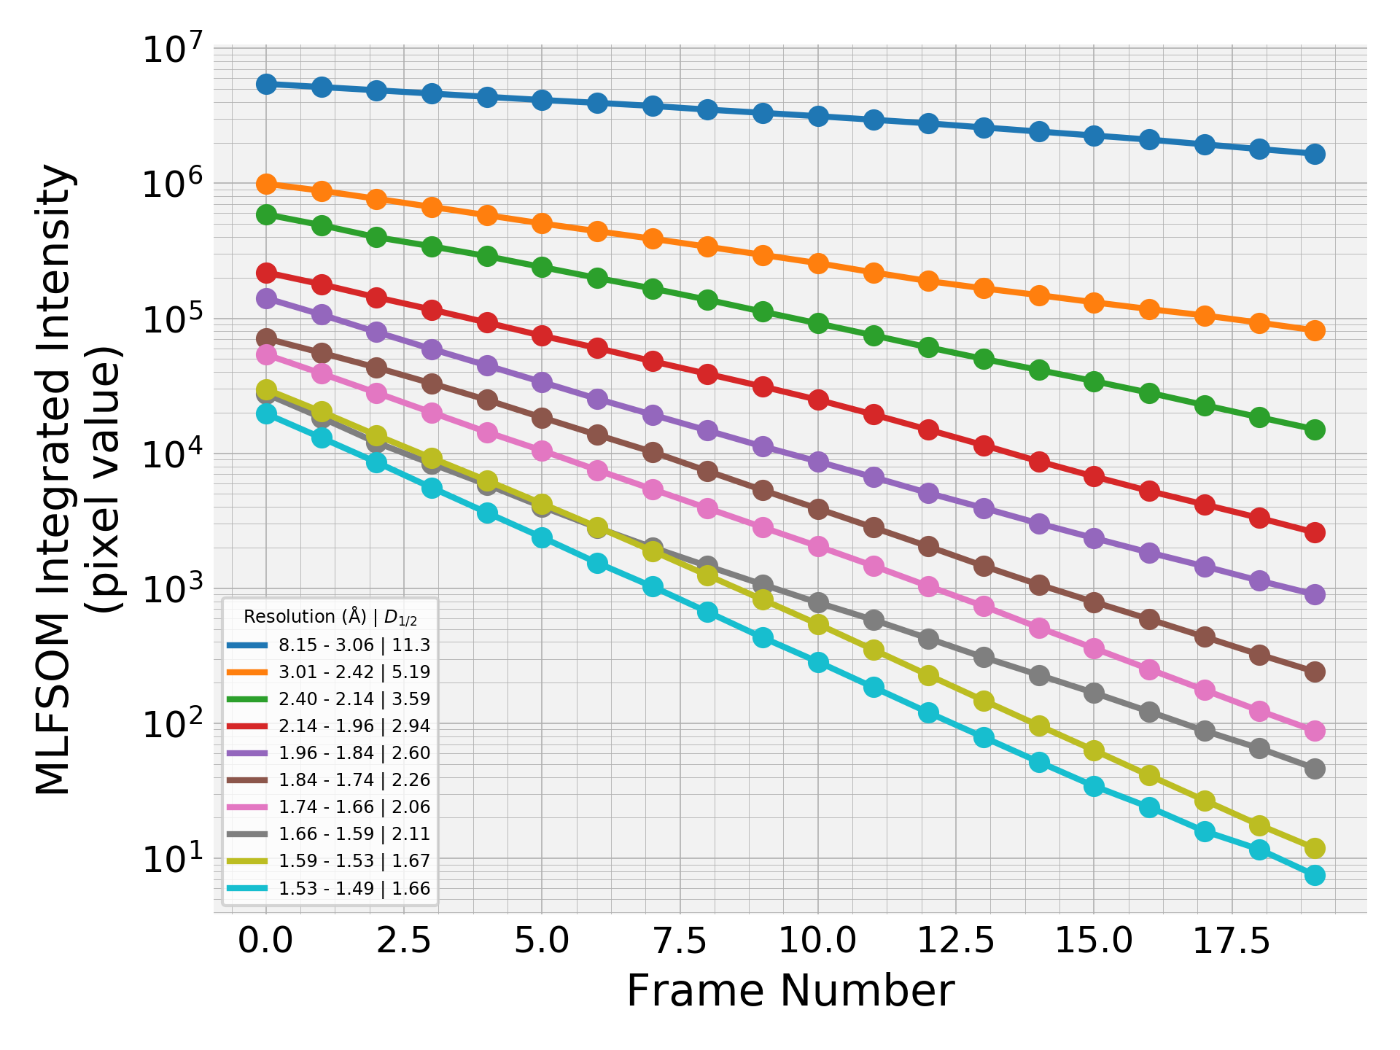
Integrated intensity by resolution shells
More regular decay

Slide 5
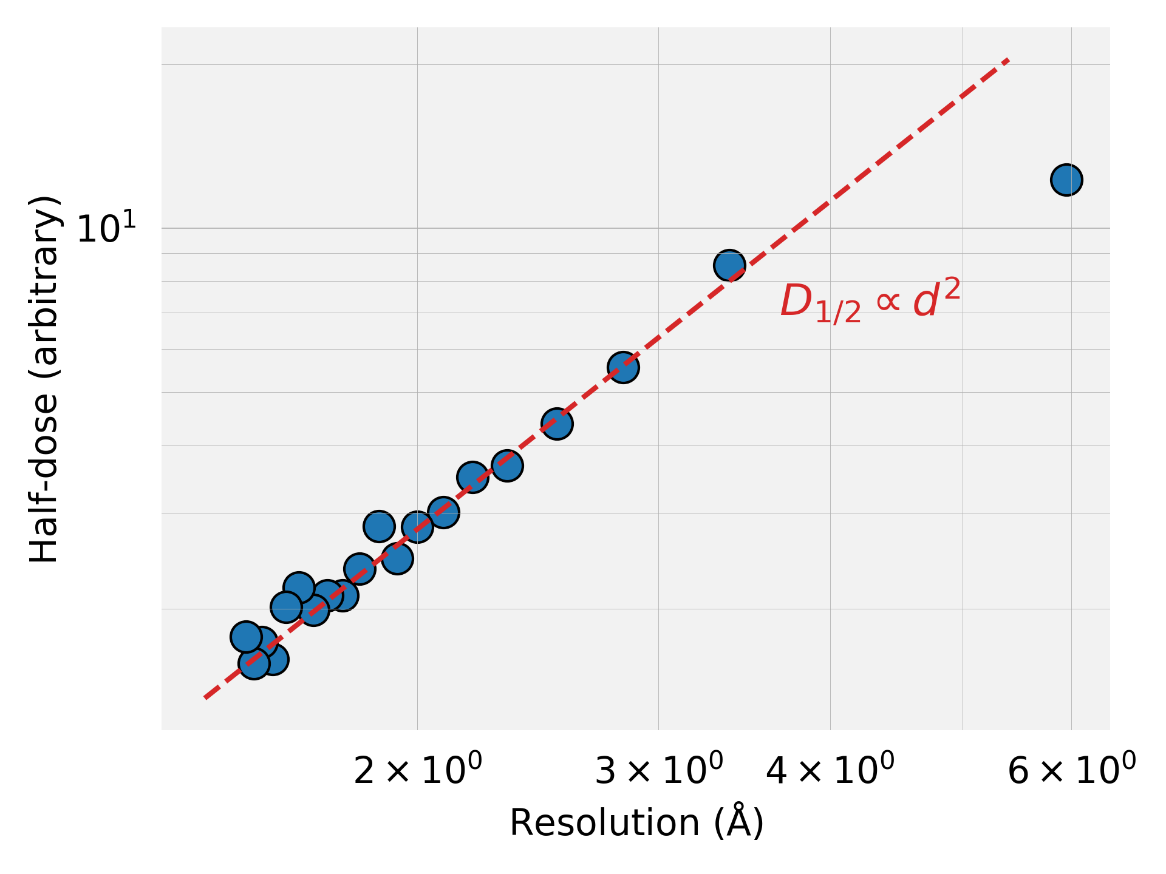
Half-dose vs. resolution
Seems like obeying the d² law. I need to increase the max resolution and get better stats though.

Slide 6
OBSERVATIONS & NOTES
This simulation is again at 1.5 A resolution. It is better to go for higher res i.e. 1.1-1.2 A which improves stats significantly.

